Slide 1
Why we need multiple web archives:
The case of blog.reidreport.com
02-13-2019
Puneeth Bikkasandra
Old Dominion University

Slide 2
Why do we need archiving?
We need evidence to make informed decisions about :
Personal, Political, Business, Policy..etc.
Archive is the evidence material and its system of processing, organization, presentation and access.
http://equivalentideas.com/journal/approaching-principles-for-independent-archives/

Slide 3
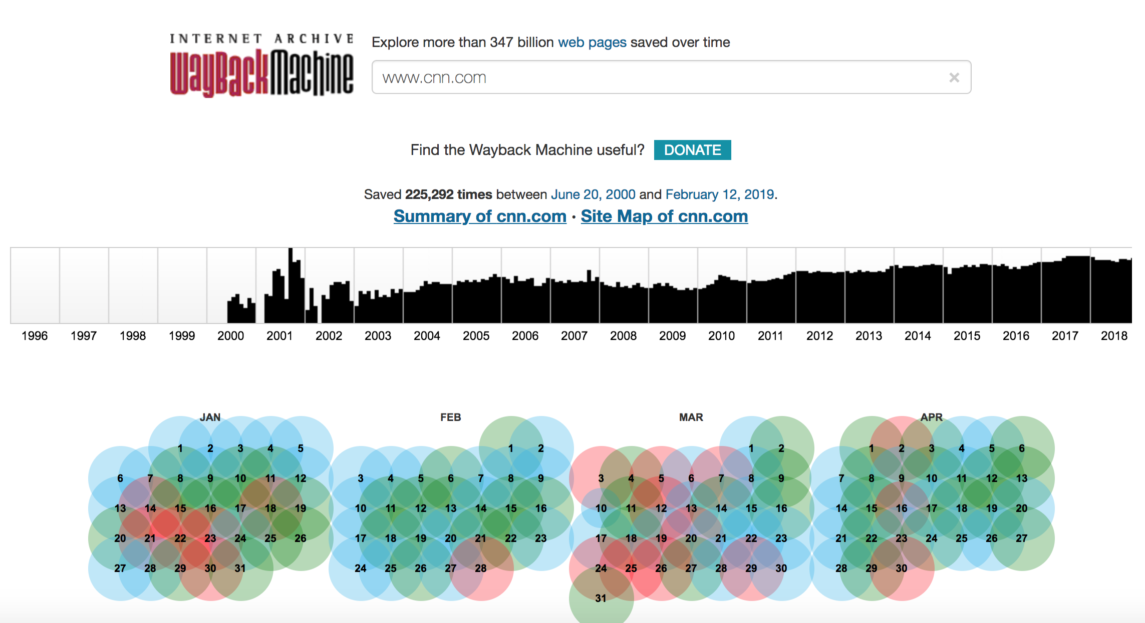
CNN.com copies archived on Wayback Machine

Slide 4
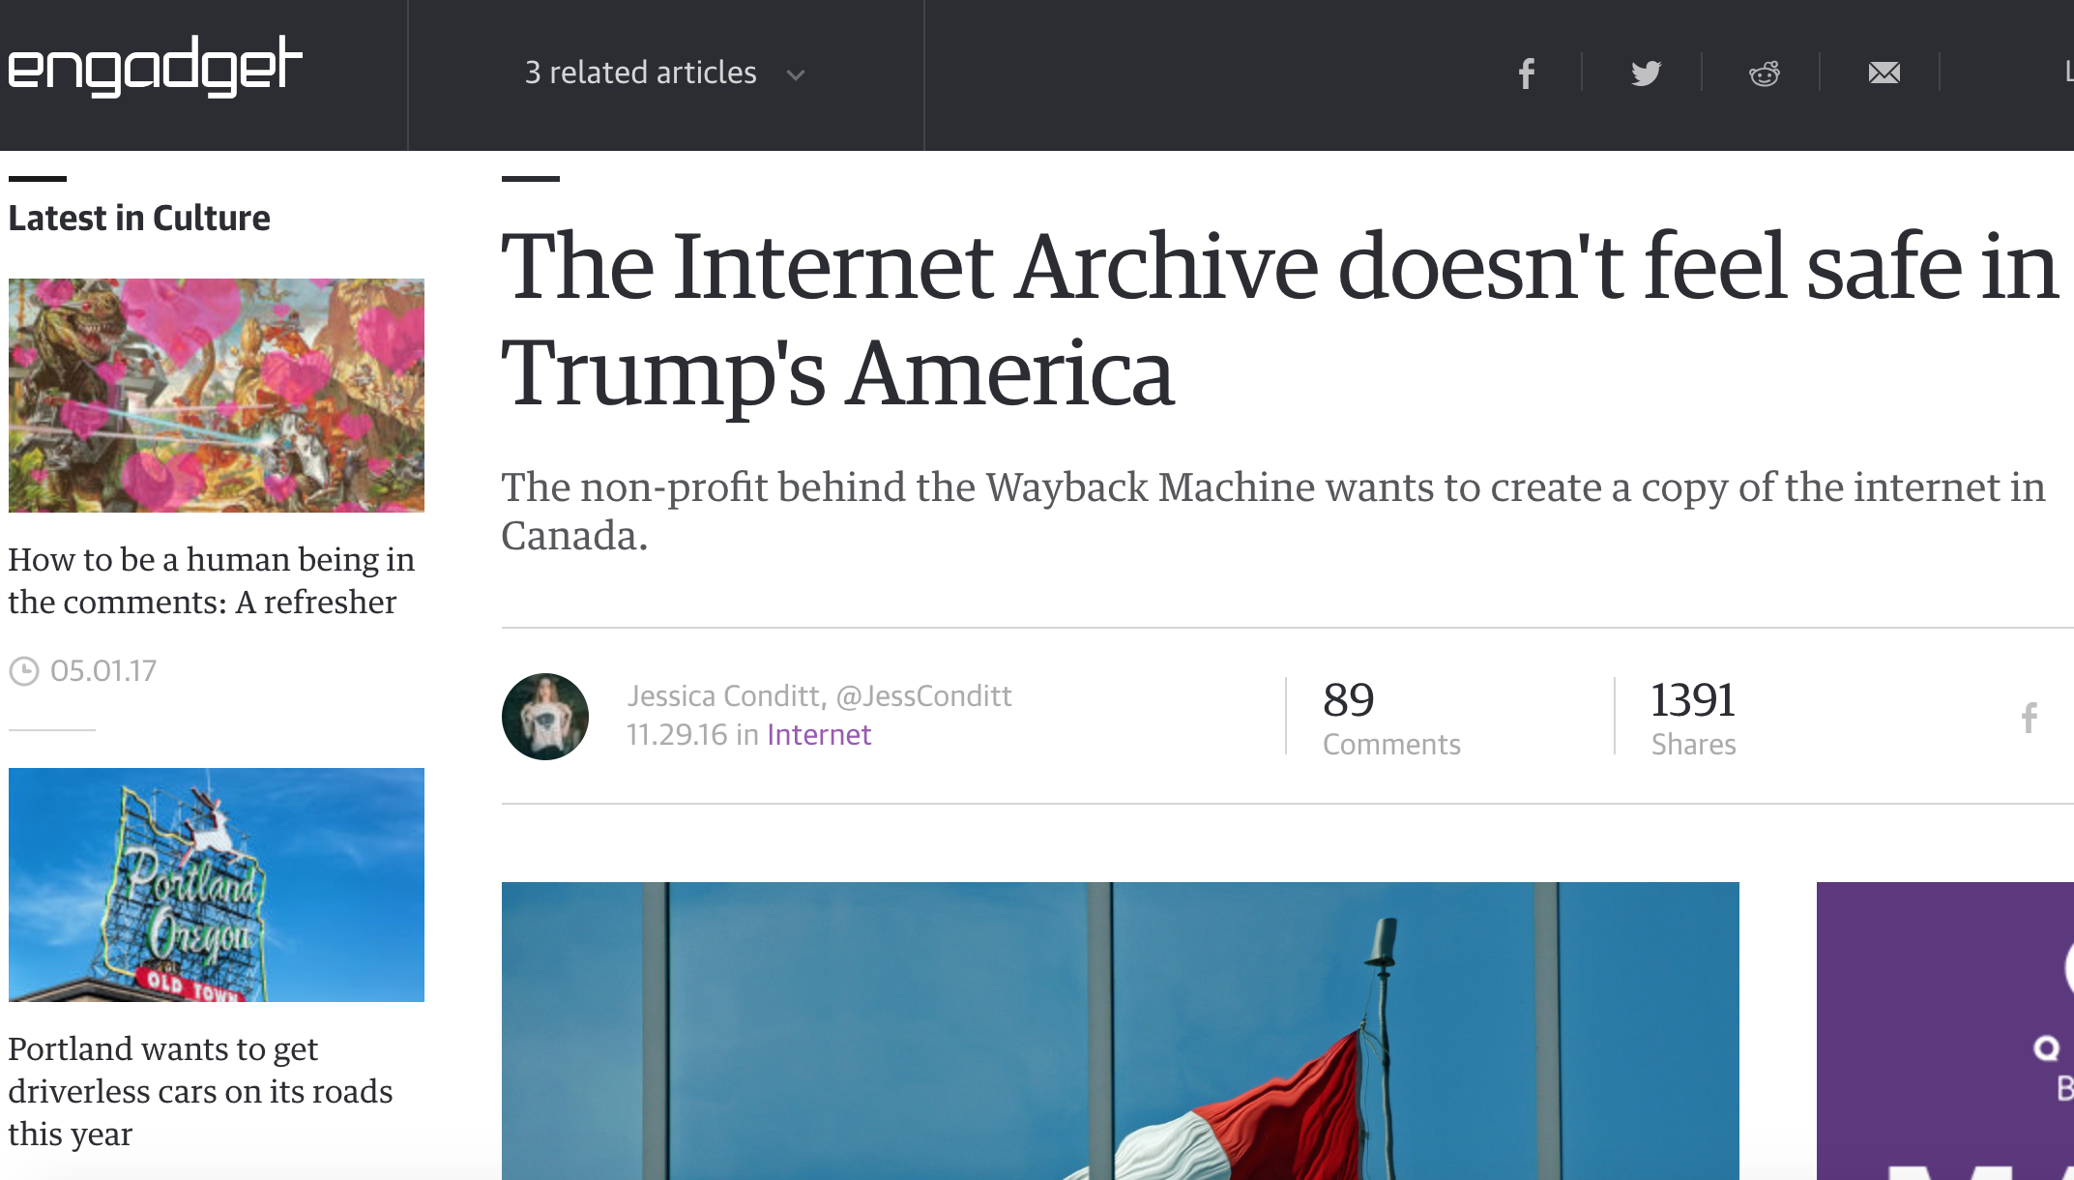
Archives are not so safe...
https://www.engadget.com/2016/11/29/the-internet-archive-doesnt-feel-safe-in-trumps-america/

Slide 5
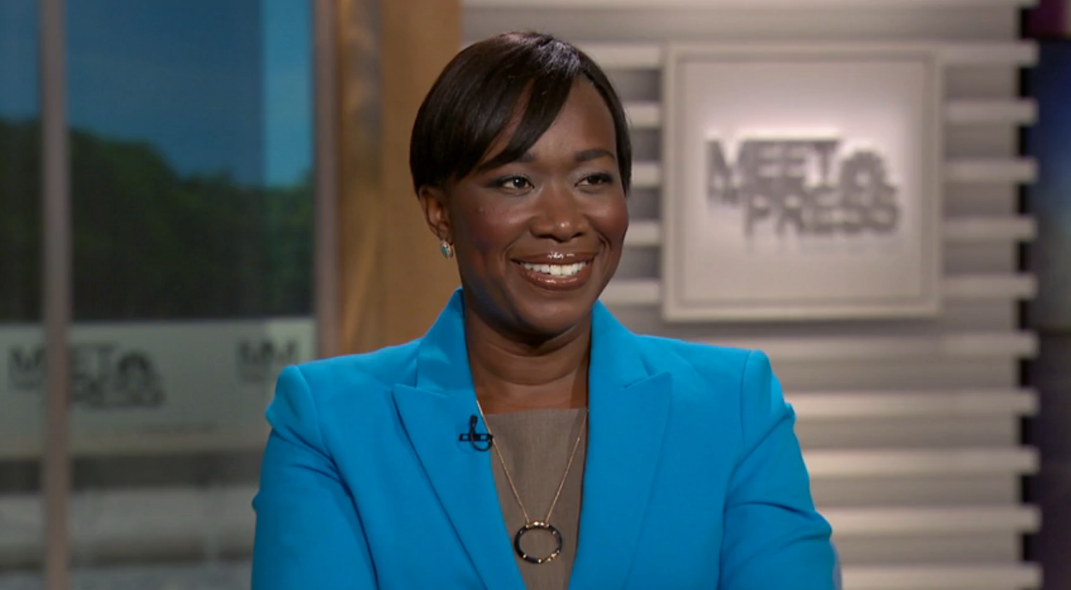
Curious case of ‘Joy Ann Reid’
American cable television-host, national correspondent @MSNBC
Co-host of Wake Up South Florida, a morning radio talk show broadcast from Radio One and The Reid Report
Political Party : Democratic.
Author : blog.reidreport.com
An Avid Blogger!!!
https://en.wikipedia.org/wiki/Joy_Reid

Slide 6
Joy Reid Saga:
Active on blog.reidreport.com since year 2005.
Made series of homophobic comments on Former Gov. Charlie Crist of Florida.
Later, decided to take down the blog posts caring for the consequences.
12/2017 - Approach Internet Archive, complaining the blog/archive records for being hacked.
https://ws-dl.blogspot.com/2018/04/2018-04-24-why-we-need-multiple-web.html

Slide 7
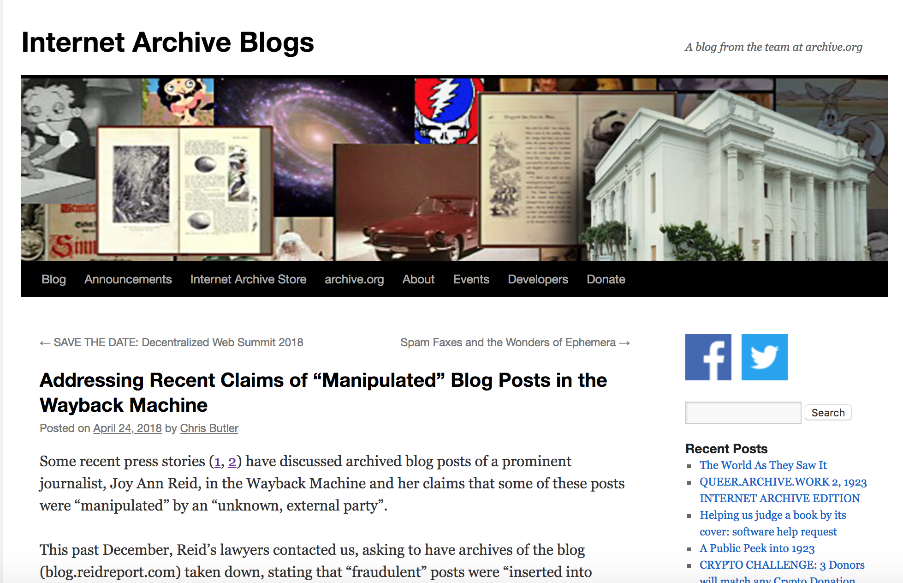
Internet archive denies the hacking and keeps blog’s record active!!!
http://blog.archive.org/2018/04/24/addressing-recent-claims-of-manipulated-blog-posts-in-the-wayback-machine/

Slide 8
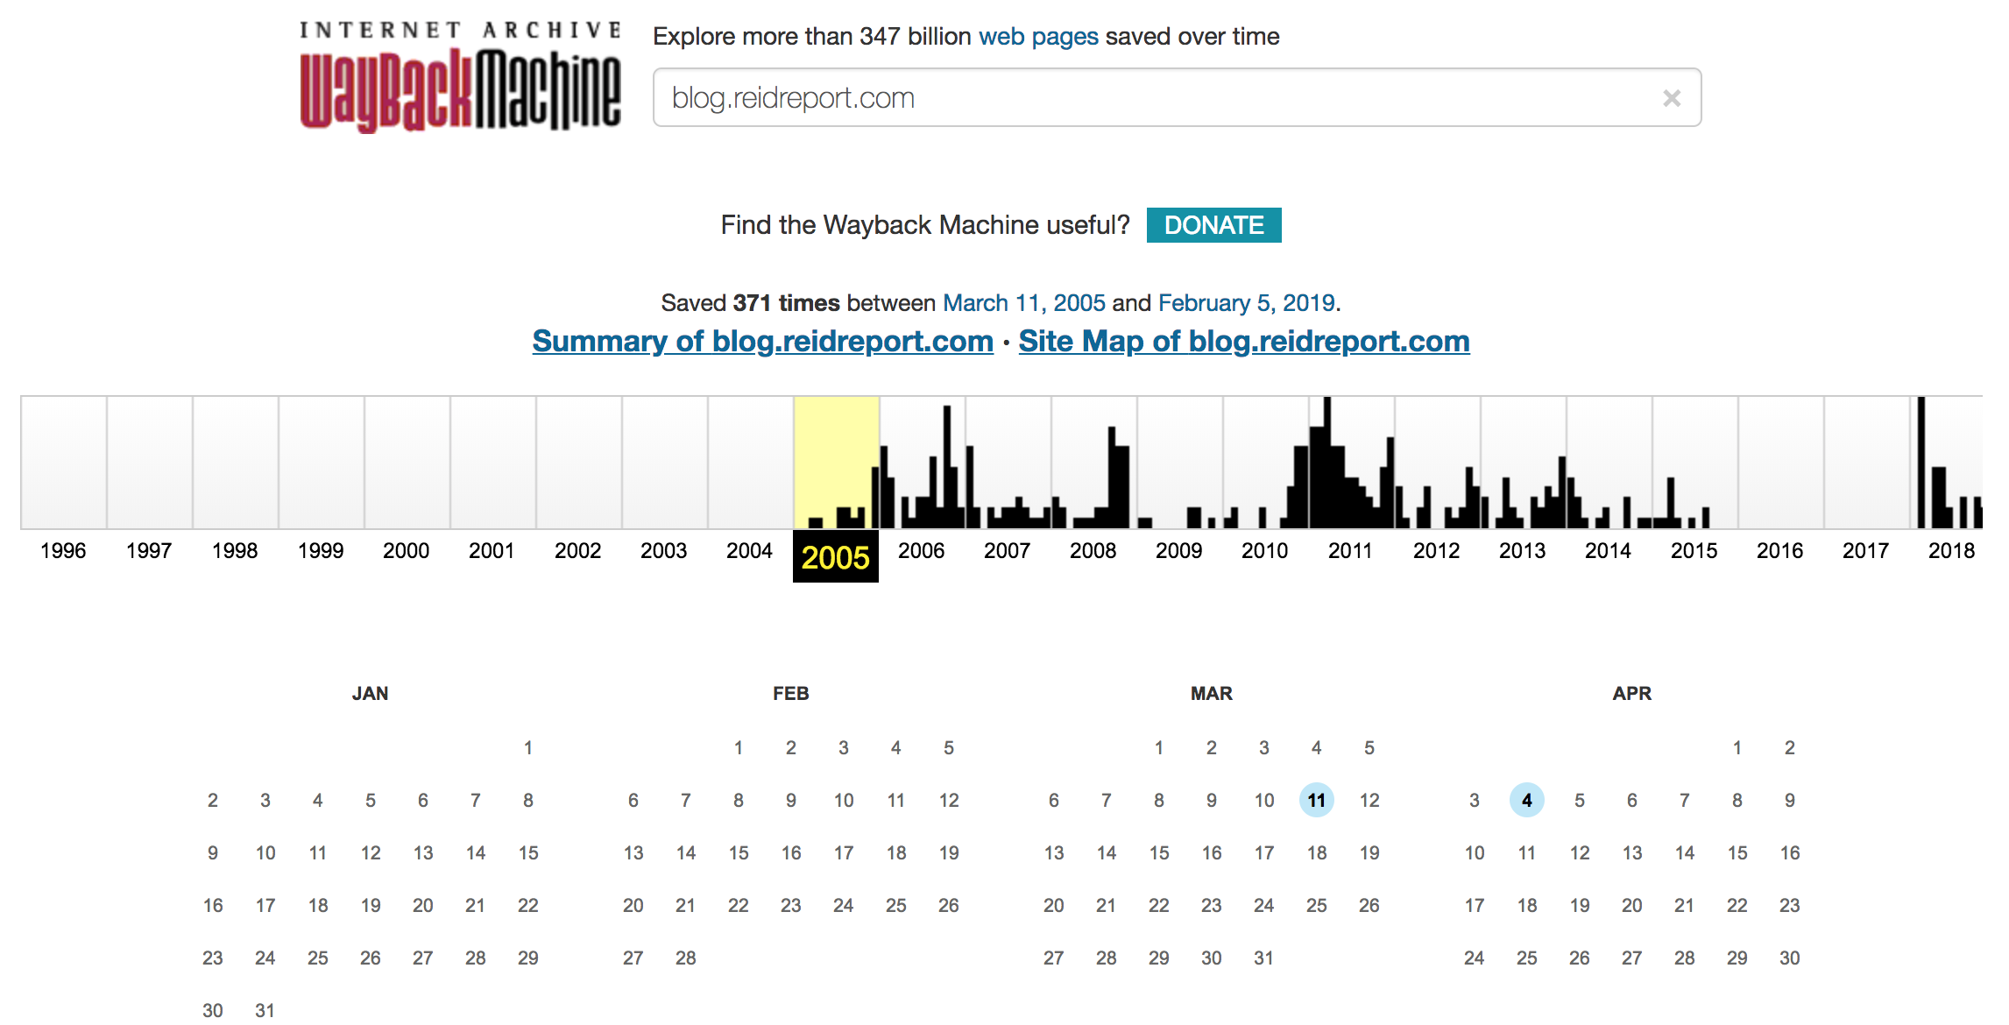
First copy of the blog at Internet Archive - 03/11/2005 && 13 archived records (in total)

Slide 9
Exclusion of robots.txt...
Request for excluding the robots.txt on live blog, which prevents “ia_archiver” , a crawler from Internet Archive.
So no more archiving of “blog.reidreport.com”...!
Levels of exclusion on robots.txt:
02/16/2018 - blocked admin section of wordpress
02/21/2018 - blocked all the robots.
04/24/2018 - blocking only “ia_archiver”..!!
https://ws-dl.blogspot.com/2018/04/2018-04-24-why-we-need-multiple-web.html

Slide 10
robots.txt presence?
At present the blog is not accessible.
curl -i http://blog.reidreport.com/robots.txt
HTTP/1.1 404 Not Found
Server: nginx/1.14.1
Date: Mon, 11 Feb 2019 12:10:46 GMT
Content-Type: text/html
Transfer-Encoding: chunked
Connection: keep-alive
Vary: Accept-Encoding
X-Endurance-Cache-Level: 2
https://ws-dl.blogspot.com/2018/04/2018-04-24-why-we-need-multiple-web.html

Slide 11
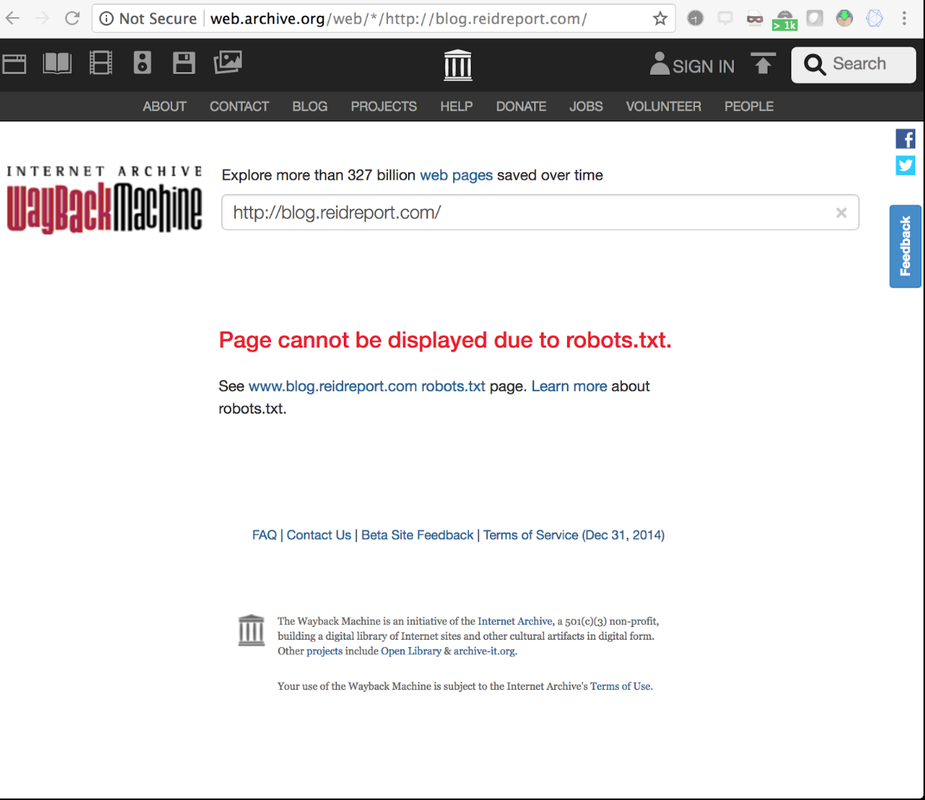
Blog is no more found on Wayback Machine!
Following the robots.txt exclusion,the blog is not found on the Internet Archive.
But, what if we had multiple
archiving platforms?

Slide 12
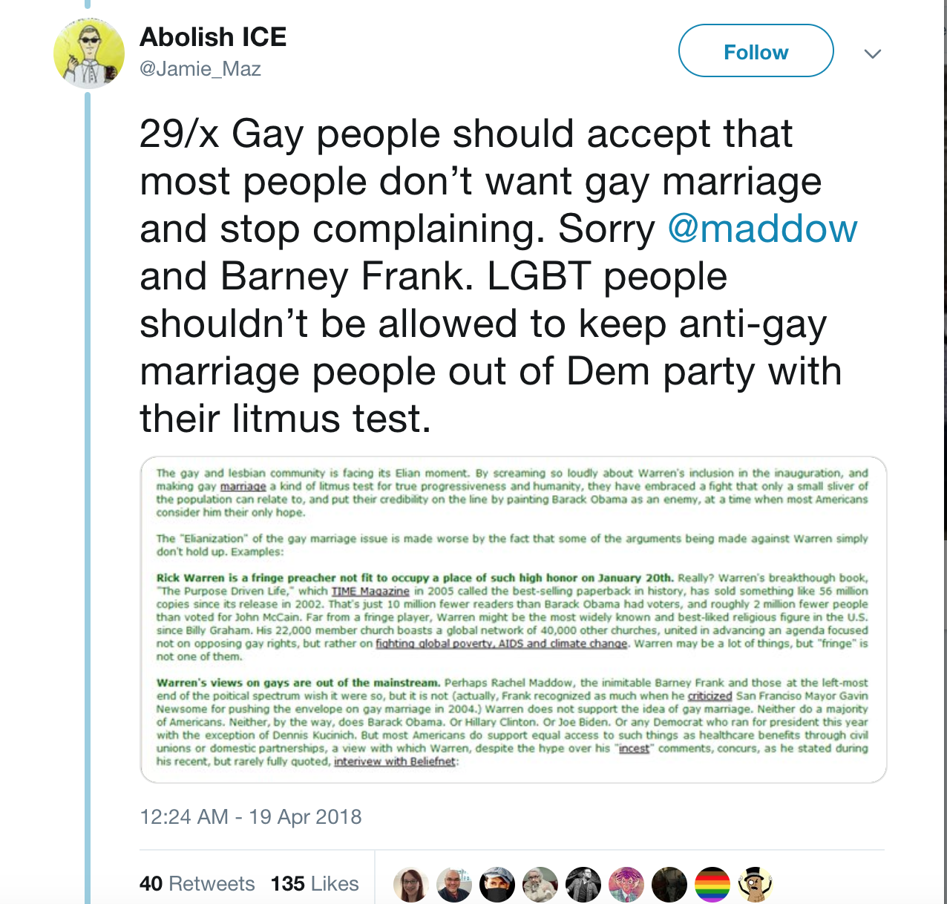
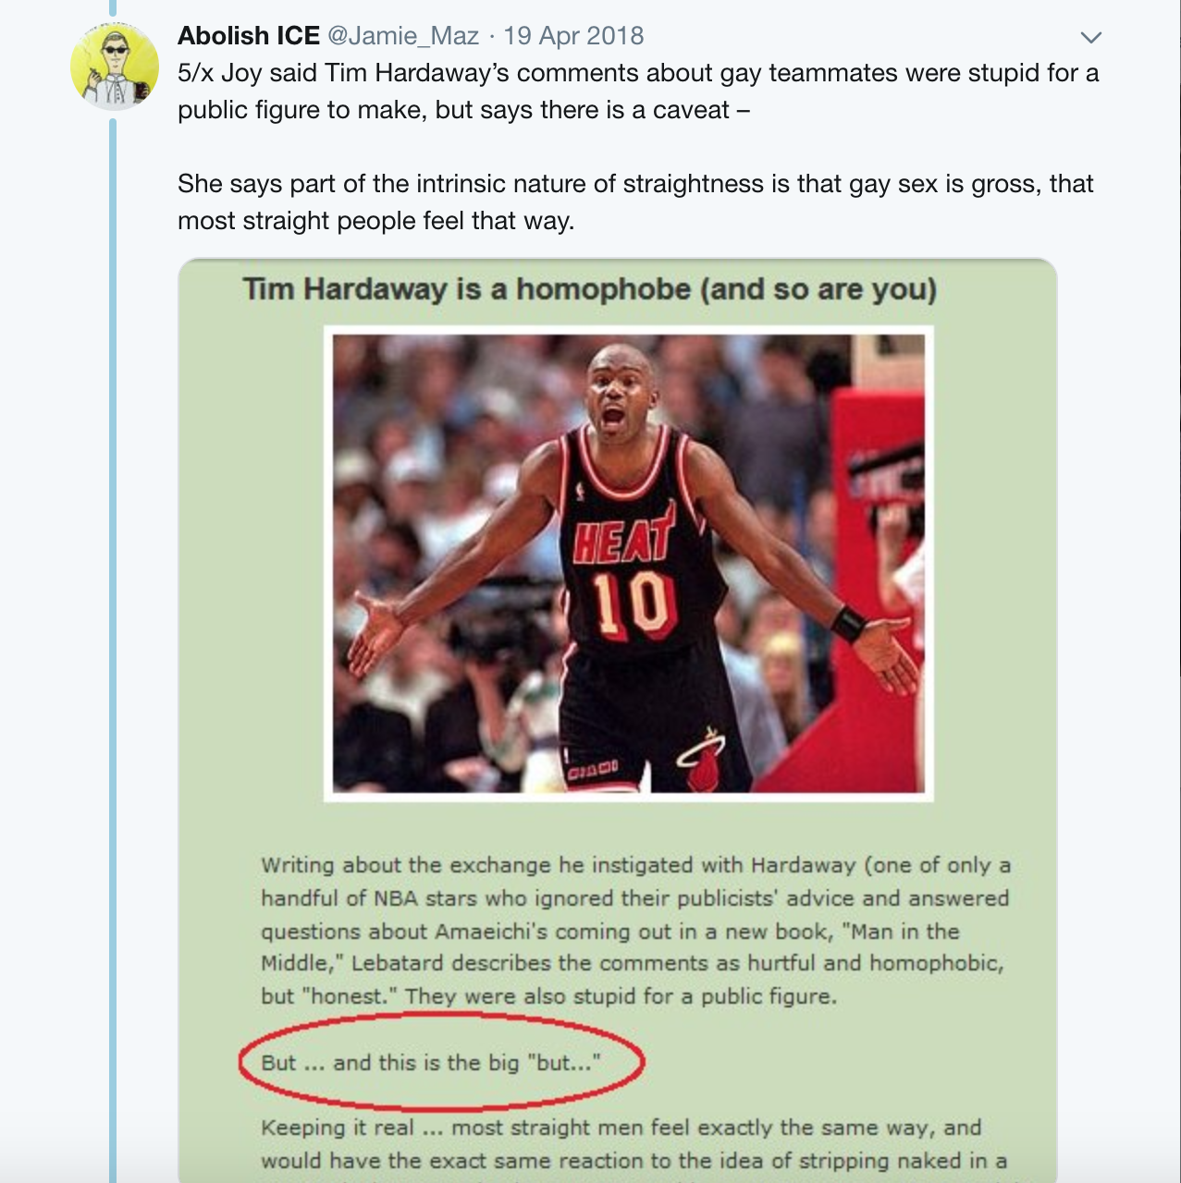
Meanwhile @Jamie_Maz claims evidence of original blog..
https://ws-dl.blogspot.com/2018/04/2018-04-24-why-we-need-multiple-web.html
http://webarchive.loc.gov/all/20060125004941/http://blog.reidreport.com/

Slide 13
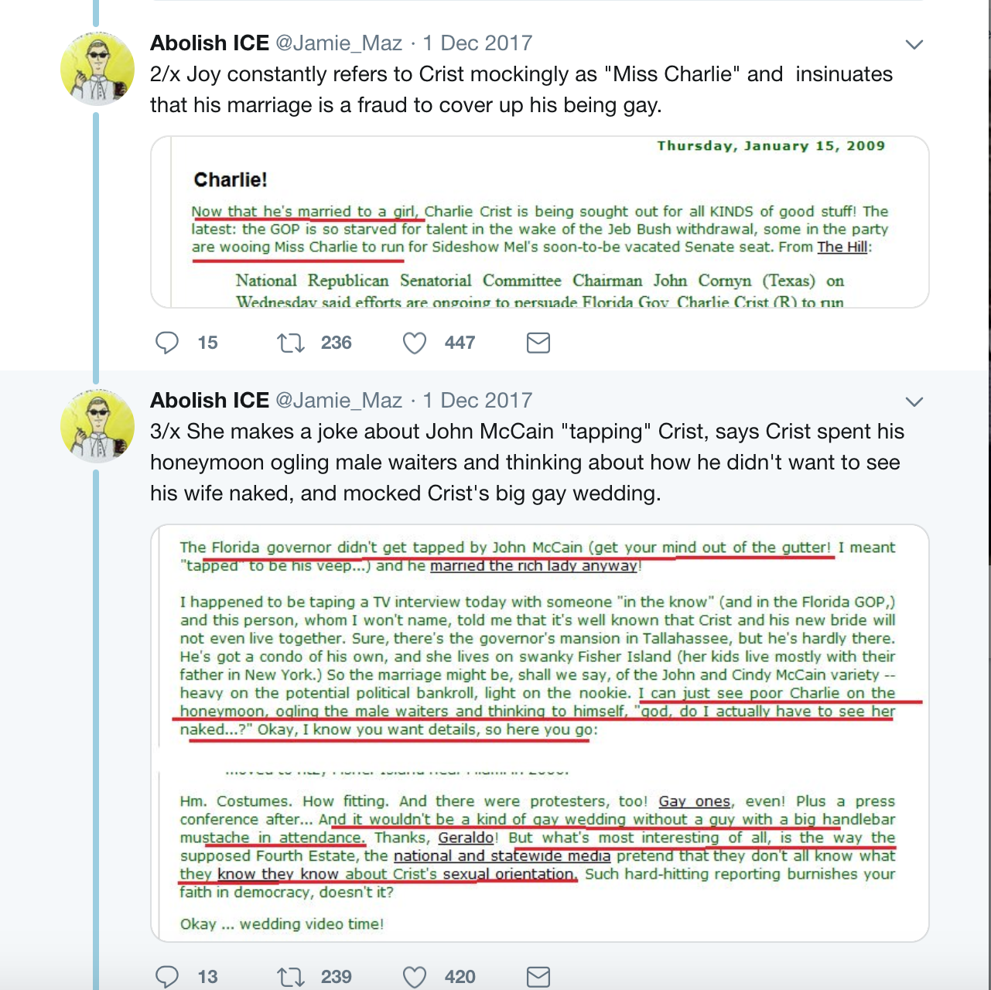
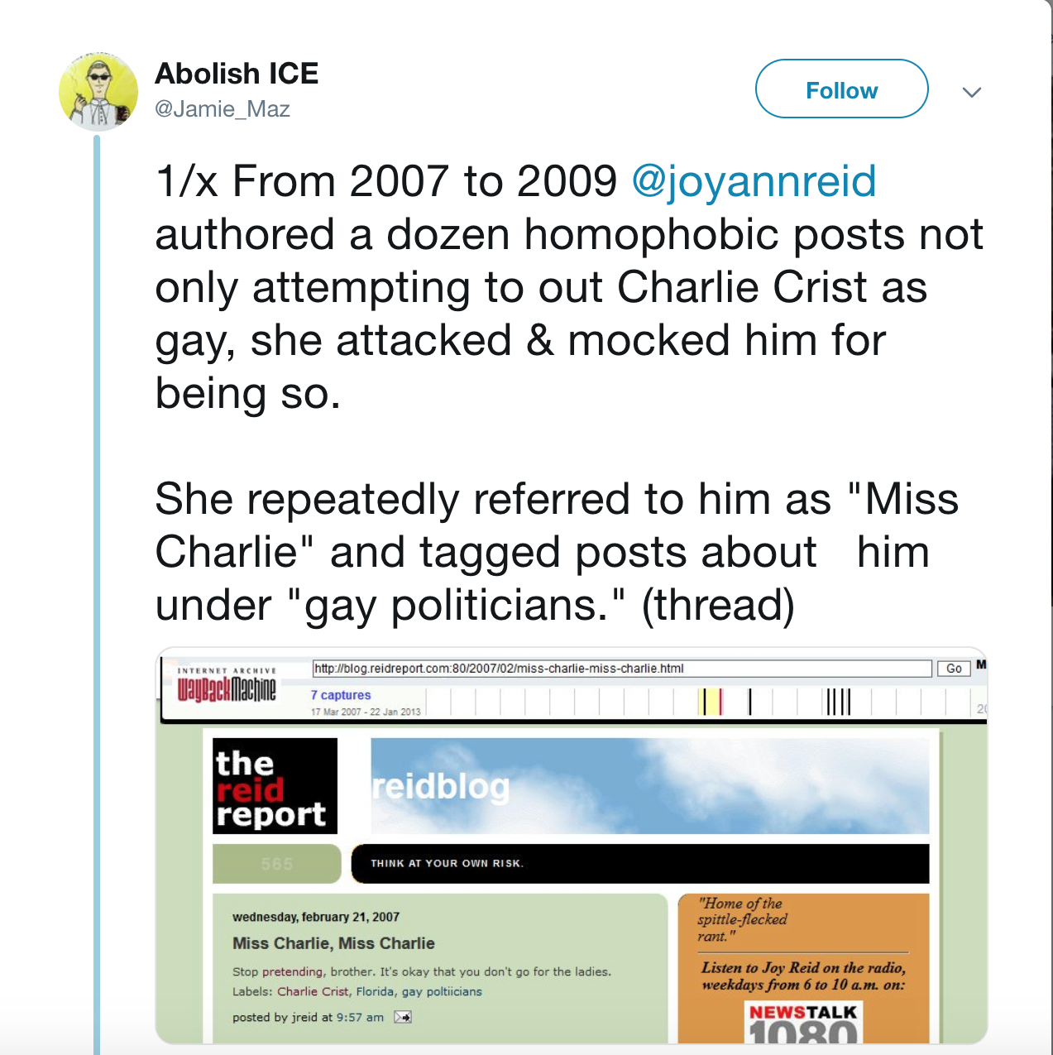
@Jamie_Maz : Original Comments
https://ws-dl.blogspot.com/2018/04/2018-04-24-why-we-need-multiple-web.html

Slide 14
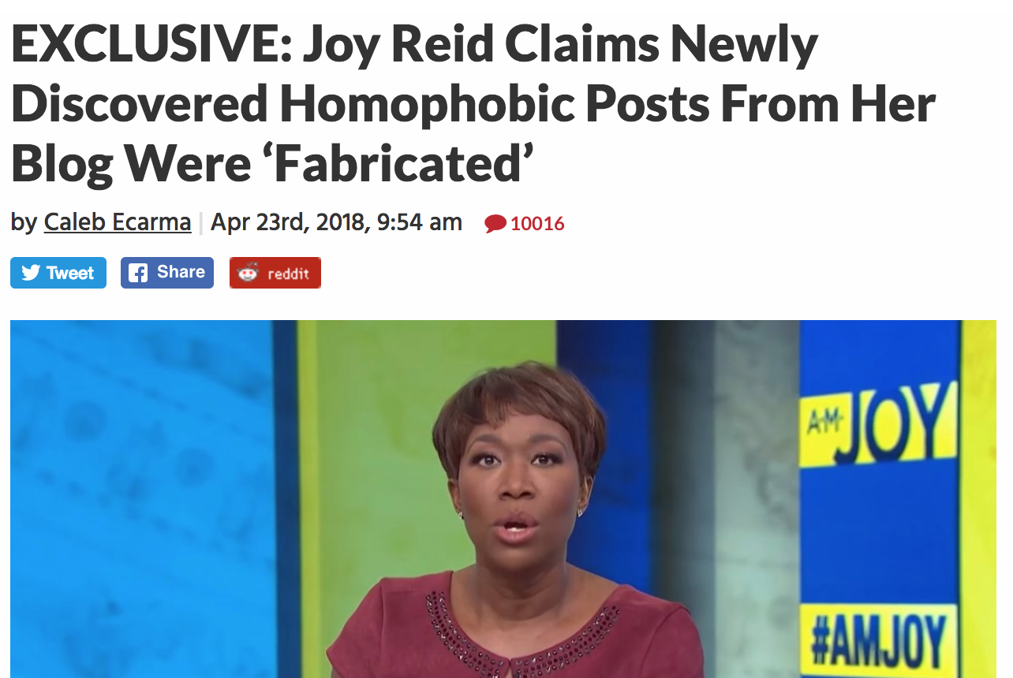
Joy Reid Apologizes!!
https://www.mediaite.com/online/exclusive-joy-reid-claims-newly-discovered-homophobic-posts-from-her-blog-were-fabricated/

Slide 15
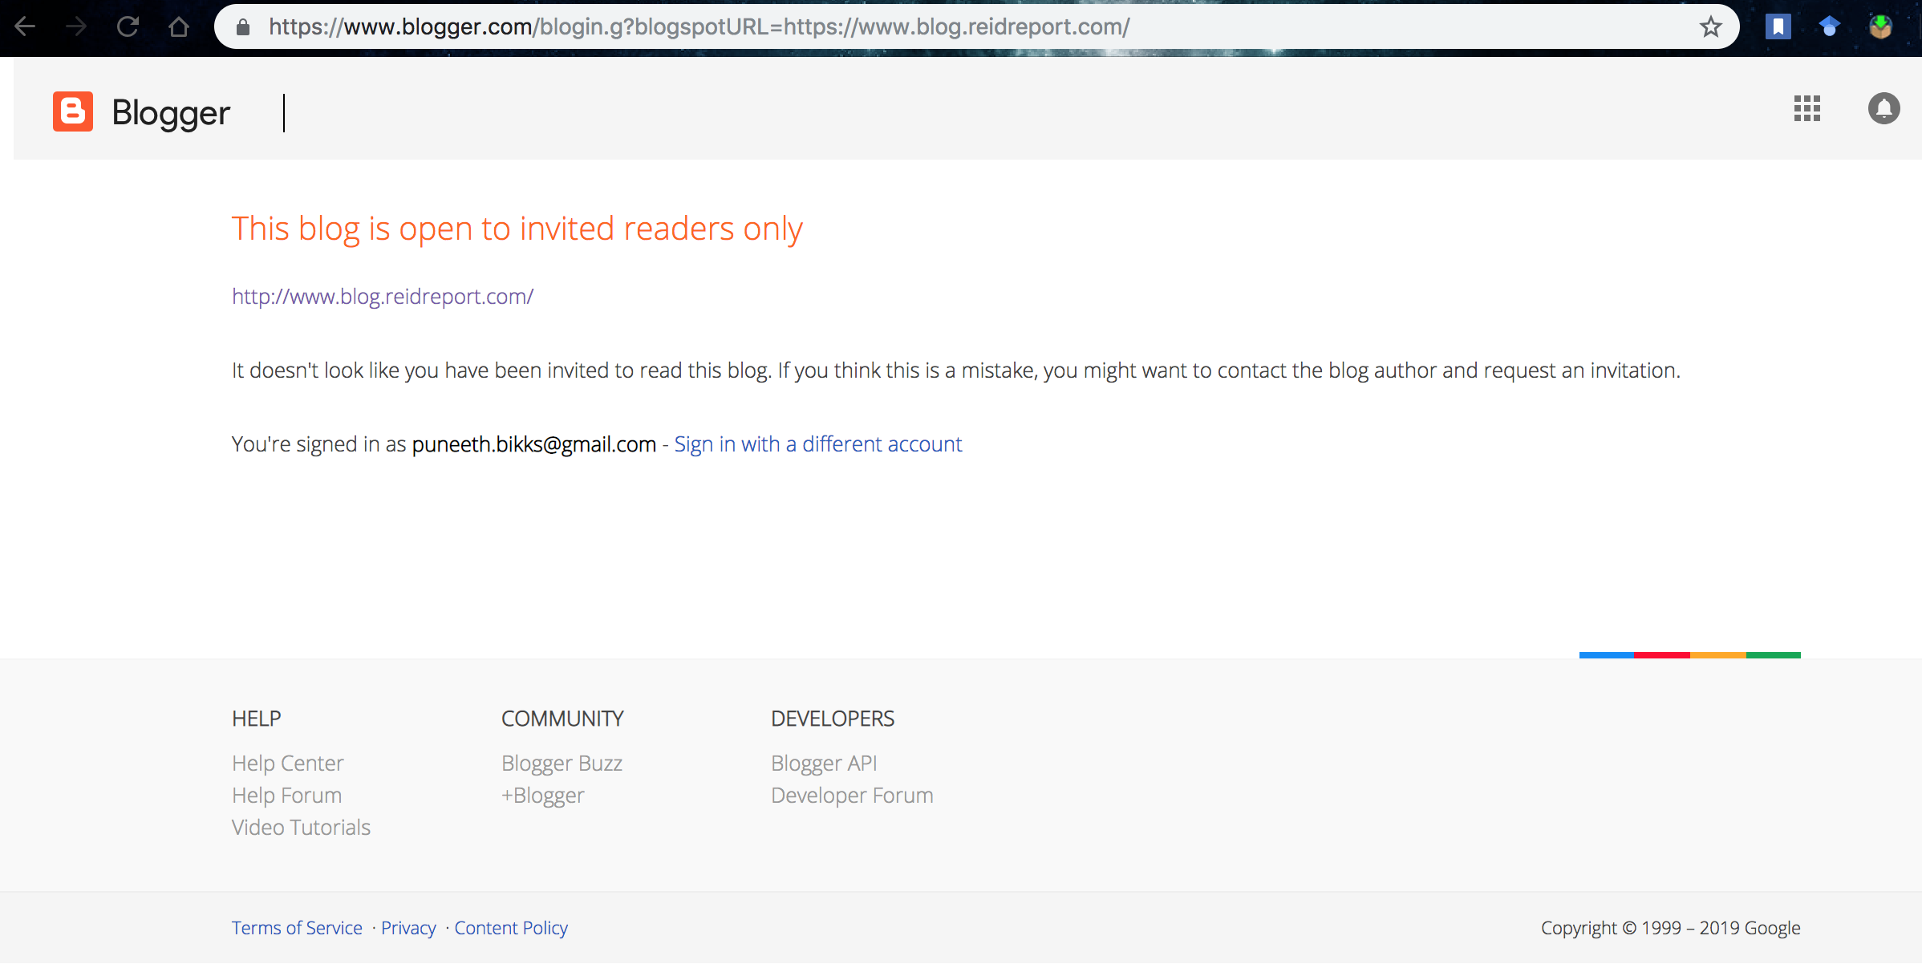
The blog now needs an invitation..!

Slide 16
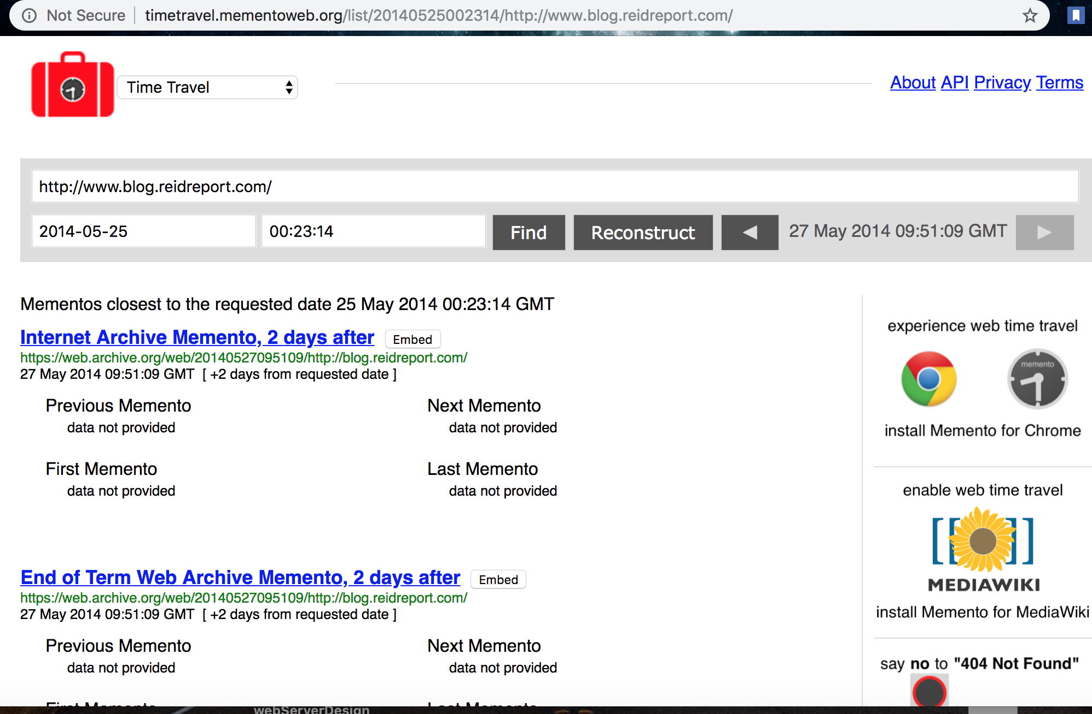
blog.reidport.com is found in 5 different archives..

Slide 17
curl -i https://memgator.cs.odu.edu/timemap/link/http://blog.reidreport.com/
HTTP/1.1 200 OK
Access-Control-Allow-Origin: *
Access-Control-Expose-Headers: Link, Location, X-Memento-Count, X-Generator
Content-Type: application/link-format
Date: Mon, 11 Feb 2019 12:45:45 GMT
X-Generator: MemGator:1.0-rc7
X-Memento-Count: 479
Transfer-Encoding: chunked
<http://blog.reidreport.com/>; rel="original",
<https://memgator.cs.odu.edu/timemap/link/http://blog.reidreport.com/>; rel="self"; type="application/link-format",
<http://archive.md/20050311024758/https://blog.reidreport.com/>; rel="first memento"; datetime="Fri, 11 Mar 2005 02:47:58 GMT",
https://ws-dl.blogspot.com/2018/04/2018-04-24-why-we-need-multiple-web.html

Slide 18
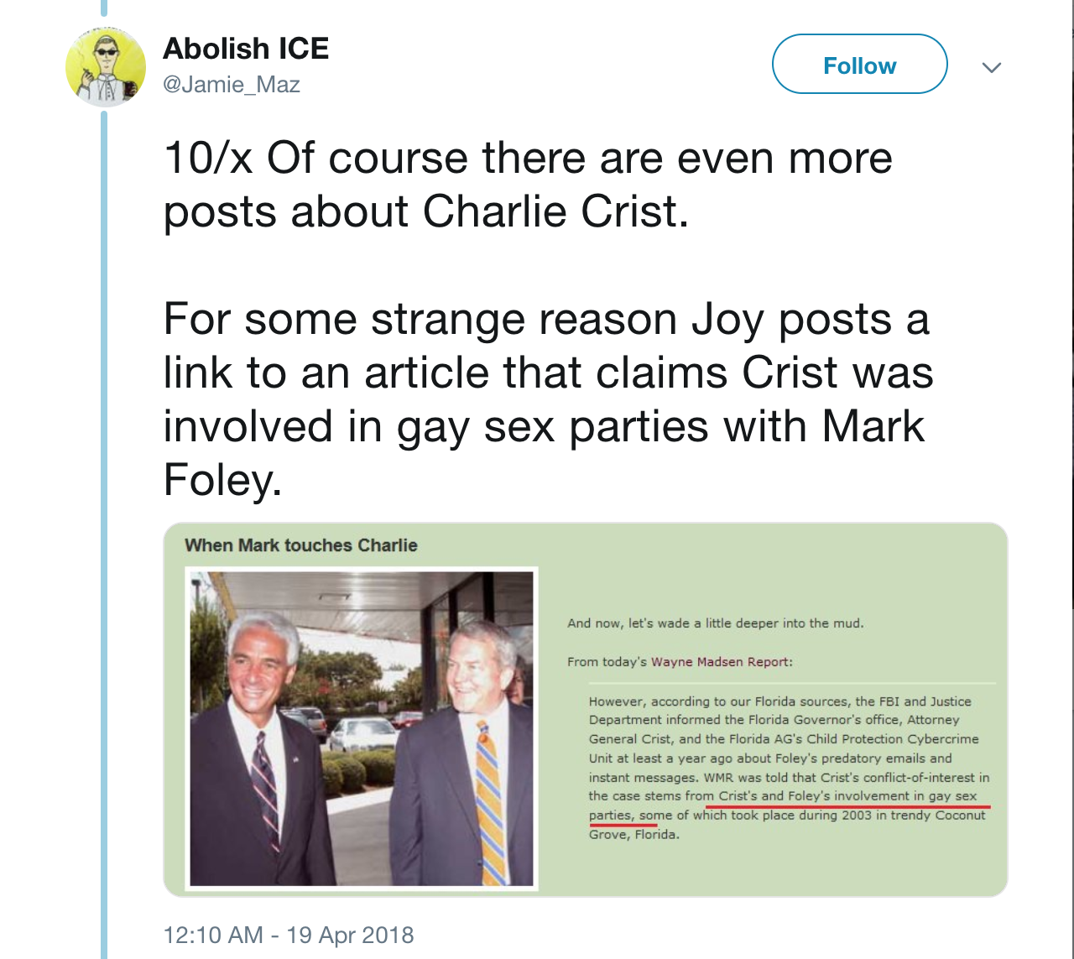
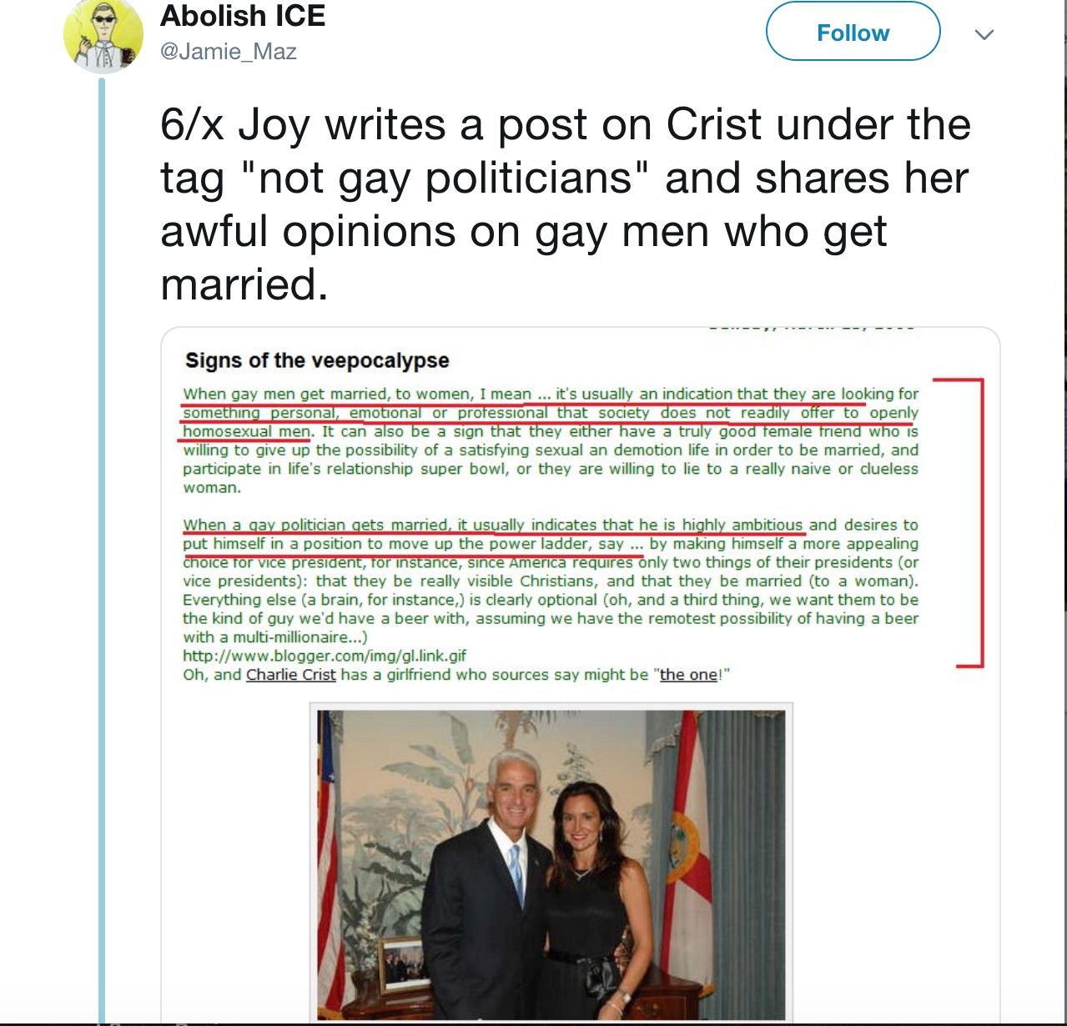
Comments on Charlie Crist...
http://webarchive.loc.gov/all/20061010125903/http://blog.reidreport.com/

Slide 19
Joy Reid Apologizes!!
https://www.mediaite.com/online/exclusive-joy-reid-claims-newly-discovered-homophobic-posts-from-her-blog-were-fabricated/

Slide 20
Tweets from @Jamie_Maz were unearthed from “Library of Congress” web archive,
which was then handled by Internet Archive.
It appears that the blog pages are archived in multiple archives, the possibility of these archives being hacked to modification is feeble.
It can be concluded that the evidence from multiple archives and a corresponding analysis from Internet Archive Engineers, that the claim is vague and was made to hide the consequences.
Some Facts:
https://ws-dl.blogspot.com/2018/04/2018-04-24-why-we-need-multiple-web.html

Slide 21
Some More Analysis...
Along these lines, there were further claims about blog being hacked and Internet Archive saving the modified blog pages.
But, if they claim, only few pages are modified through hacking, blog.reidreport.com would have been hacked long back and nobody noticed it.
The archived page shows 2006 blog status
6 posts on January 11,
12 posts on January 10 and
11 posts on January 09.
It is clear that Reid interacted with the blog regularly and a chance of not finding out the fabrication is not acceptable.
https://ws-dl.blogspot.com/2018/04/2018-04-24-why-we-need-multiple-web.html

Slide 22
Technically Feasible, but highly unlikely…!
Nonetheless, with multiple copies geographically and administratively dispersed throughout the globe, an adversary would have had to hack multiple web archives and alter their contents, or have hacked the original site (blog.reidreport.com) approximately 12 years ago for adulterated pages to have been hosted at all the different web archives…
At least 3 archived web pages in the Library of Congress that confirm the claims of @Jamie_Maz.
http://www.smashcompany.com/philosophy/joy-reid-and-why-we-need-multiple-web-archives
https://ws-dl.blogspot.com/2018/04/2018-04-24-why-we-need-multiple-web.html

Slide 23
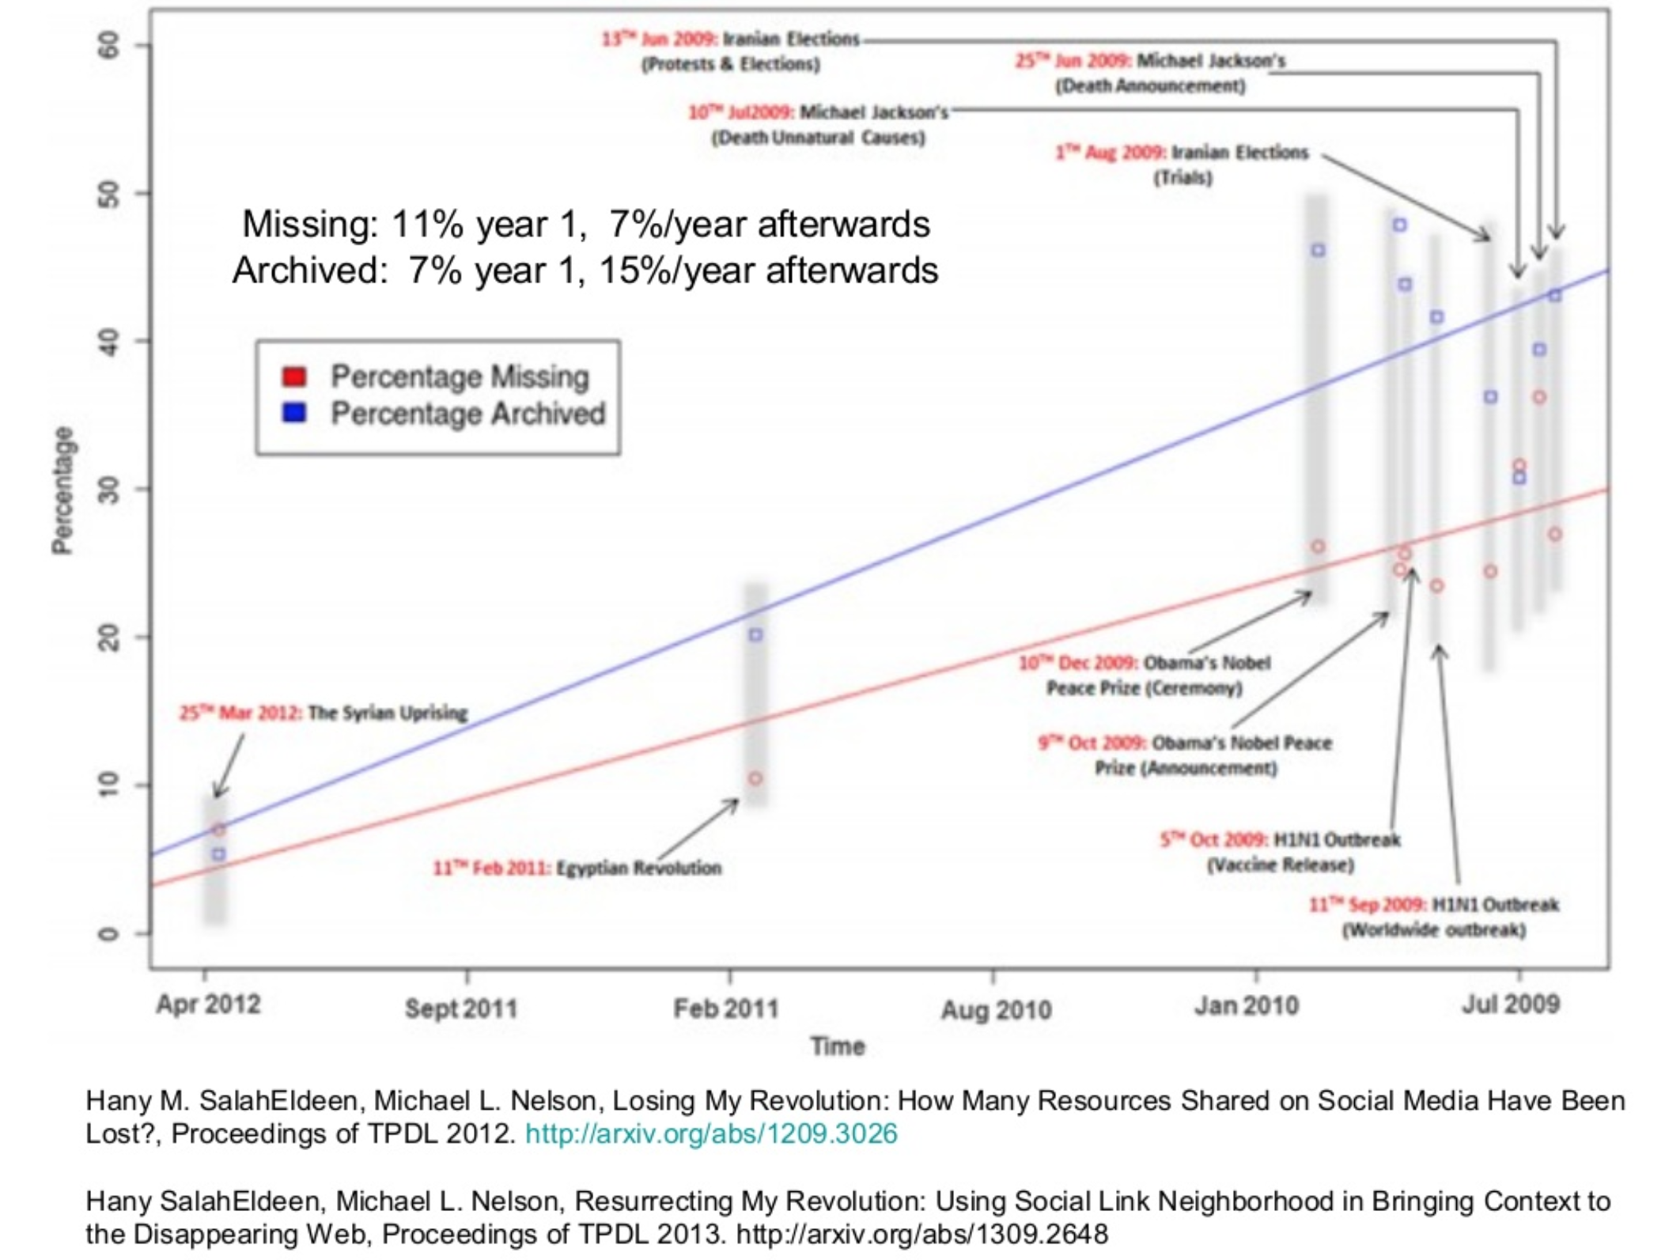
Lost and Archived Statistics
https://www.slideshare.net/phonedude/we-need-multiple-independent-web-archives

Slide 24
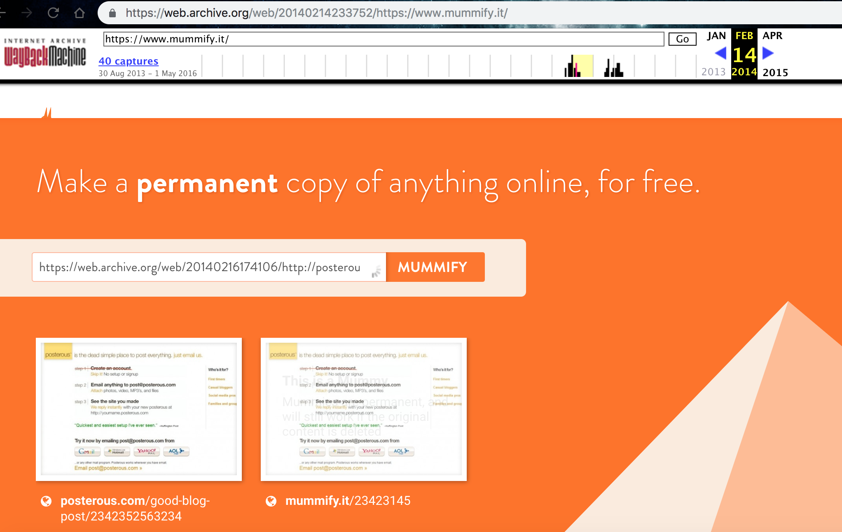
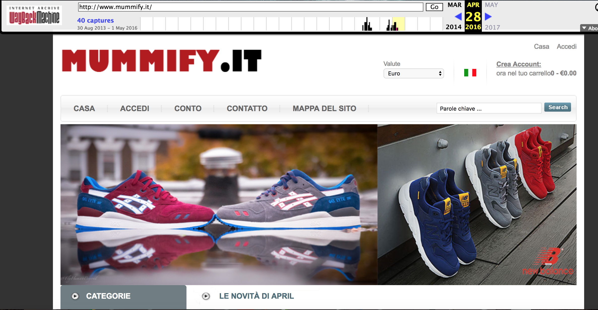
Some archives may hit extinction, also unmaintainable(1 TB = $4700)
https://en.wikipedia.org/wiki/List_of_Web_archiving_initiatives
https://www.slideshare.net/phonedude/we-need-multiple-independent-web-archives

Slide 25
Conclusion :
Archived web is incomplete, unstable, unreliable and unevenly distributed, but yet resourceful (evident in blog.reidreport.com).
Multiple web archiving needs to be universally accessible and aid others creating backup copies (as found on wayback machine)
Records on the archives must remain accessible, long after the service is stopped.
http://equivalentideas.com/journal/approaching-principles-for-independent-archives/
https://www.slideshare.net/phonedude/we-need-multiple-independent-web-archives

